Slide 1

Female Reproductive System
Al-Farabi Kazakh National University
Higher School of Medicine
Pregnancy and Childbirth. Lactation

Slide 2
LEARNING OUTCOMES
As a result of the lesson you will be able to:
list the major hormones that regulate pregnancy and explain their roles;
describe a woman’s bodily adaptations to pregnancy;
identify the physical and chemical stimuli that increase uterine contractility in late pregnancy;
describe the mechanism of labor contractions;
name and describe the three stages of labor;
describe the physiological changes that occur in a woman during the weeks following childbirth.
Al-Farabi Kazakh National University
Higher School of Medicine

Slide 3
Introduction
Gestation (pregnancy) lasts an average of 266 days from conception to childbirth, but the gestational calendar is usually measured from the first day of the woman’s last menstrual period (LMP). Thus, the birth is predicted to occur 280 days (40 weeks) from the LMP.
conceptus the embryo or fetus as well as the placenta and membranes associated with it
blastocyst The developing individual is a hollow ball of the first 2 weeks,
embryo from day 16 through week 8,
fetus from the beginning of week 9 until birth. attached by way of an umbilical cord to a disc-shaped placenta on the uterine wall.
The placenta provides fetal nutrition and waste disposal, and secretes hormones that regulate pregnancy, mammary development, and fetal development.
neonate For the first 4 weeks after birth
Al-Farabi Kazakh National University
Higher School of Medicine

Slide 4

Al-Farabi Kazakh National University
Higher School of Medicine

Slide 5
Hormones of Pregnancy
estrogens
progesterone
human chorionic gonadotropin
human chorionic somatomammotropin.
Other Hormones - thyrotropin, prolactin, and ACTH ,HCG, pituitary thyrotropin, and human chorionic thyrotropin ,Aldosterone ,relaxin
Importance
indicator of the well-being of the fetus.
secreted primarily by the placenta,
corpus luteum is an important source of hormones in the first several weeks.
Al-Farabi Kazakh National University
Higher School of Medicine
Notes:
Process of formation of sperms is called spermatogenesis and the process of formation of ovum is called oogenesis.
Spermatogenesis takes place in the testes and oogenesis takes place in the ovaries.
No polar bodies are formed in spermatogenesis. Two polar bodies are formed in oogenesis.
Spermatogenesis takes 74 days to complete while oogenesis takes days to years.
All stages of spermatogenesis are completed inside the testis while some processes of oogenesis is carried out outside ovaries.
The growth phase is short in spermatogenesis but long in oogenesis.
Spermatogenesis form motile make gametes but oogenesis form non-motile gametes.

Slide 6
Adjustments to Pregnancy
Digestive System, Nutrition, and Metabolism
— morning sickness
— Constipation and heartburn
— raised basal metabolic rate
— increased nutrational need
Circulatory System
— The mother’s blood volume rises about 30%
— Cardiac output rises about 30% to 40% above normal by 27 weeks
Respiratory System
— the tidal volume and minute ventilation increase about 40%
Urinary System
— the glomerular filtration rate increases by 50% and urine output is slightly elevated
Integumentary System
— The skin grows to accommodate expansion of the abdomen and breasts and the added fat deposition in the hips and thighs
Uterine Growth and Weight Gain
— The uterus weighs about 50 g when a woman is not pregnant and about 900 g by the end of pregnancy.
Al-Farabi Kazakh National University
Higher School of Medicine

Slide 7
Child birth
in the seventh month of gestation, the fetus normally turns into the head-down vertex position
  acting as a wedge that widens the mother’s cervix, vagina, and vulva during birth
fetus is a passive player in its own birth
  expulsion achieved by contractions of mother’s uterine and abdominal muscles
  fetus may play a role chemically by stimulating labor contractions
  sending chemical messages that signify when it is developed enough to be born
Al-Farabi Kazakh National University
Higher School of Medicine
Notes:
Process of formation of sperms is called spermatogenesis and the process of formation of ovum is called oogenesis.
Spermatogenesis takes place in the testes and oogenesis takes place in the ovaries.
No polar bodies are formed in spermatogenesis. Two polar bodies are formed in oogenesis.
Spermatogenesis takes 74 days to complete while oogenesis takes days to years.
All stages of spermatogenesis are completed inside the testis while some processes of oogenesis is carried out outside ovaries.
The growth phase is short in spermatogenesis but long in oogenesis.
Spermatogenesis form motile make gametes but oogenesis form non-motile gametes.

Slide 8
Uterine Contractility
Braxton Hicks contractions – relatively weak contractions of the uterus over the course of gestation
labor contractions
mark the onset of parturition, the process of giving birth.
begin about 30 minutes apart and eventually occur every 1 to 3 minutes
  progesterone inhibits uterine contractions, but declines after 6 months
  estradiol stimulates uterine contractions, and continues to rise
  oxytocin promotes labor by directly stimulates muscles of myometrium and stimulates fetal membranes to produce prostaglandins, which are synergists of oxytocin in producing labor contractions
  conceptus may produce chemical stimuli promoting its own birth
  uterine stretching
Al-Farabi Kazakh National University
Higher School of Medicine

Slide 9
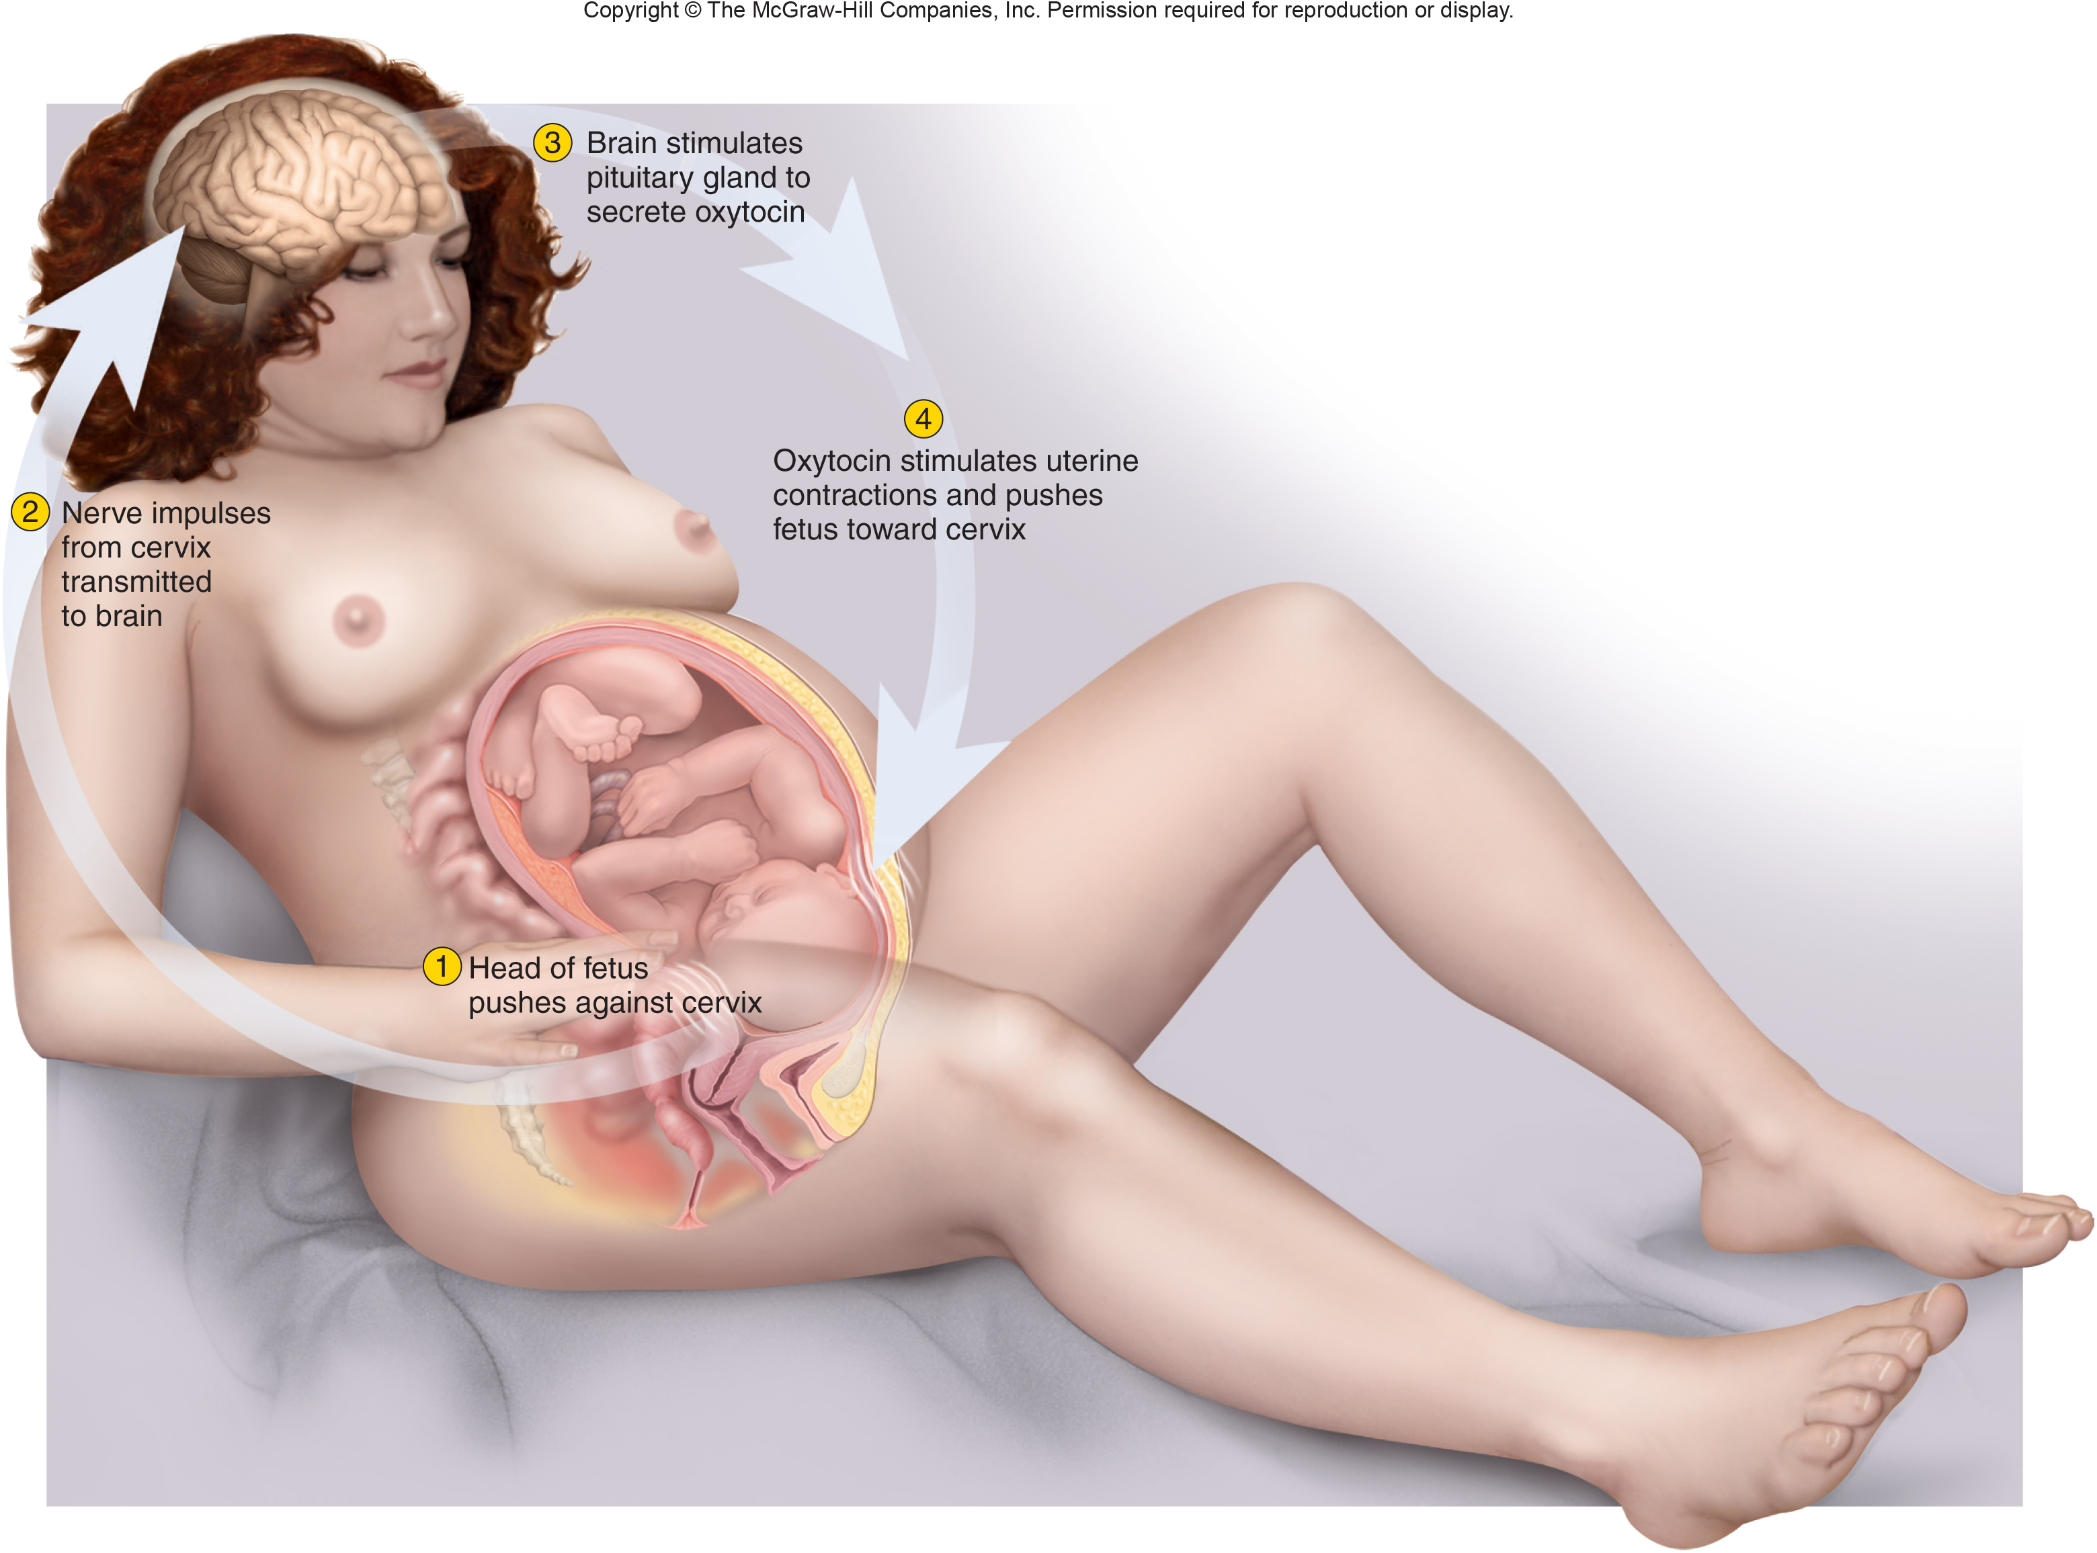
Positive feedback theory of labor
Figure from: Saladin, Anatomy & Physiology, McGraw Hill, 2018
Al-Farabi Kazakh National University
Higher School of Medicine

Slide 10
Stages of Labor
Dilation – lasting 8 to 24 hours
dilation of cervical canal and effacement (thinning) of cervix to reach 10 cm
breaking of the waters-rupture of fetal membranes and loss of amniotic fluid
Expulsion - begins when the baby’s head enters vagina lasts until the baby is expelled
crowning – when the baby’s head is visible
after expulsion, attendant drains blood from umbilical vein into baby
placental stage
uterine contractions continue causing placental separation
membranes (afterbirth) inspected to be sure everything has been expelled
Al-Farabi Kazakh National University
Higher School of Medicine

Slide 11
The Puerperium
first 6 weeks postpartum (after birth)
  period in which the mother’s anatomy and physiology stabilize and the reproductive organs return nearly to the pregravid state (condition prior to pregnancy)
    involution – shrinkage of the uterus
breast-feeding promotes involution
  suppresses estrogen secretion which would make the uterus more flaccid
  stimulates oxytocin secretion which causes myometrium to
  contract and firm up the uterus sooner
Al-Farabi Kazakh National University
Higher School of Medicine

Slide 12
Lactation
lactation – the synthesis and ejection of milk from the mammary glands
high estrogen level in pregnancy causes the ducts of the mammary glands to grow
growth hormone, insulin, glucocorticoids, and prolactin contribute to this development
progesterone stimulates the budding and development of acini at the end of the ducts
acini organized into grape-like clusters (lobules) within each breast lobe
Al-Farabi Kazakh National University
Higher School of Medicine

Slide 13
Milk Ejection
controlled by a neuroendocrine reflex
  infant’s suckling stimulates sensory receptors in nipple, signaling hypothalamus and posterior pituitary to release oxytocin
  oxytocin stimulates myoepithelial cells around each acinus
  contract to squeeze milk into duct
Al-Farabi Kazakh National University
Higher School of Medicine

Slide 14
Reference:
Saladin, Anatomy & Physiology, McGraw Hill, New York,2018
National center for case study teaching in science. https://sciencecases.lib.buffalo.edu/

